Slide 1

A Dual Analysis of NYC Business Licenses
A Machine-Learning Approach
Team #8 | CS667 – Practical Data Science
Members :- Ronak Pipaliya | Sajan Shergil |
Darpan Gorasiya
Instructor: Dr. Krishna Bathula

Slide 2

AGENDA
INTRODUCTION
BUILDING CONFIDENCE
ENGAGING THE AUDIENCE
VISUAL AIDS
FINAL TIPS & TAKEAWAYS

Slide 3

Introduction
This presentation provides an overview of the analysis conducted on the NYC Business Licenses dataset containing over 66,000 records across the five boroughs.
It highlights the methodologies used to predict missing business geolocations through regression modeling and forecast license renewal or lapse through classification.
The presentation outlines key data cleaning steps, machine learning techniques, model evaluations, and the insights derived to support data-driven decision-making for business regulation and urban policy planning.

Slide 4

Loaded Dataset The NYC Business Licenses dataset was loaded into a Pandas DataFrame for preprocessing and exploration. The dataset contained approximately 66,000 records and 31 attributes, covering business details, license information, geographic identifiers, and issuance timelines.
Initial Data Inspection Exploratory methods such as head(), info(), and describe() were applied to understand the dataset’s structure, data types, and completeness. This preliminary inspection revealed multiple missing fields, mixed data types, and non-standard ZIP code formats—indicating the need for thorough data cleaning and transformation before analysis.

Slide 5
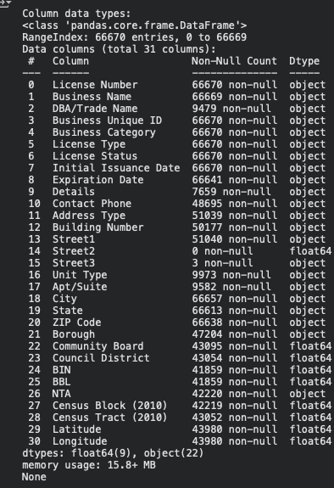
Dataset Overview

Slide 6
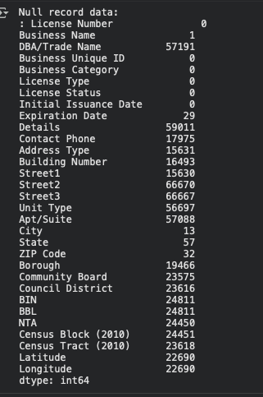
Data preprocessing & cleaning Check the null value
Initial issuance date/Expiration date converted to datetime.
Cardinality of object columns shows the important features need to taken into consideration for model training.
Identifying object type columns, exclude identifier columns, calculate the number of unique values for each, and print the results to assess cardinality for one-hot encoding suitability.

Slide 7
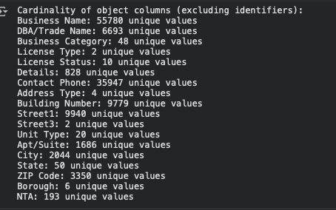

Slide 8
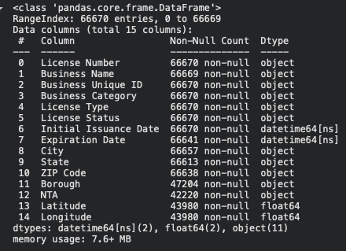
ONE HOT ENCODED COLUMNS
Dataset contains 66,670 records and 15 features after cleaning.
Focused on NYC-based businesses only (removed “Outside NYC”).
Data types: 11 categorical, 2 numeric, 2 datetime.
Missing values present in Borough, NTA, Latitude, and Longitude.
Datetime conversion: Initial Issuance Date, Expiration Date → datetime64.
Dataset size: ~7.6 MB, memory-efficient for Pandas operations.
Structured and ready for feature engineering (encoding, imputation, scaling).

Slide 9
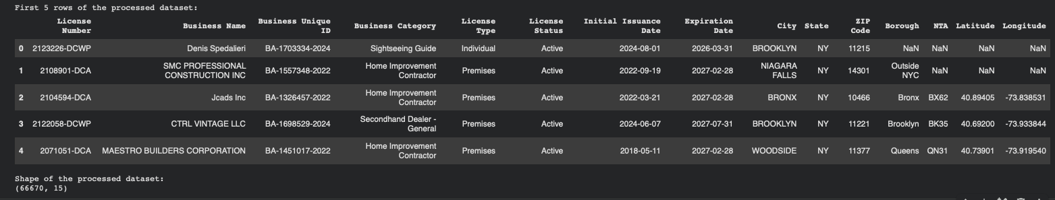

Slide 10
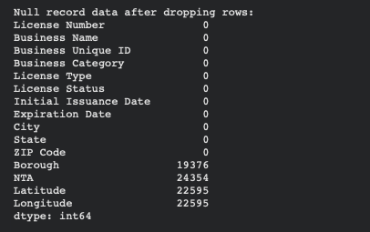
Impute missing value with median and mode
Key Steps:
ZIP Code: Standardized to 5-digit numeric format; removed invalid and non-NYC entries.
Borough: Filled missing values using ZIP-to-Borough mapping.
NTA: Imputed using ZIP-to-NTA relationships derived from valid records.
Latitude & Longitude: Retained as targets for regression prediction.
Result:
Dataset refined from 66,670 → ~56,000 records (NYC-only).
All categorical fields cleaned and spatial hierarchy (ZIP → Borough → NTA) restored.
Remaining missing values limited to coordinates for the regression task.

Slide 11
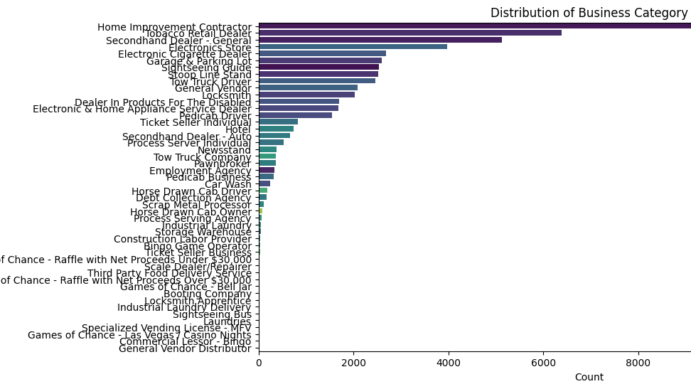

Slide 12
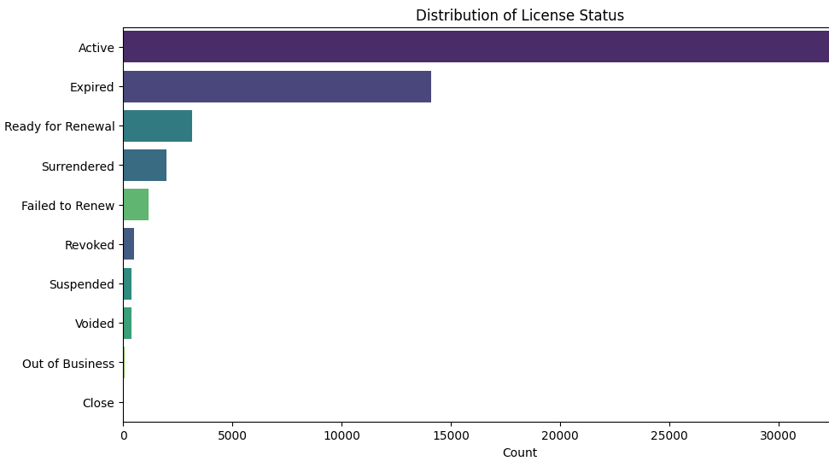

Slide 13
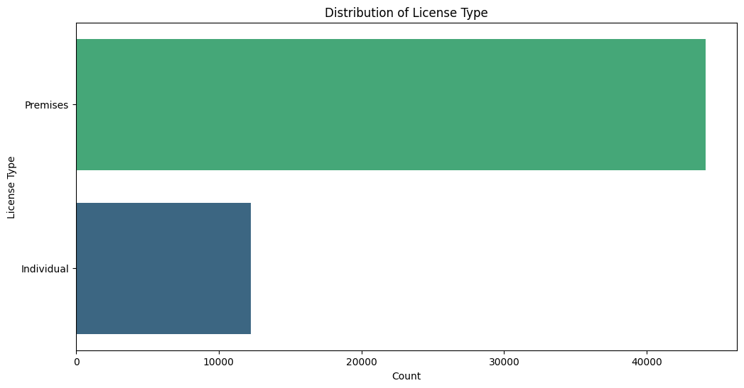

Slide 14
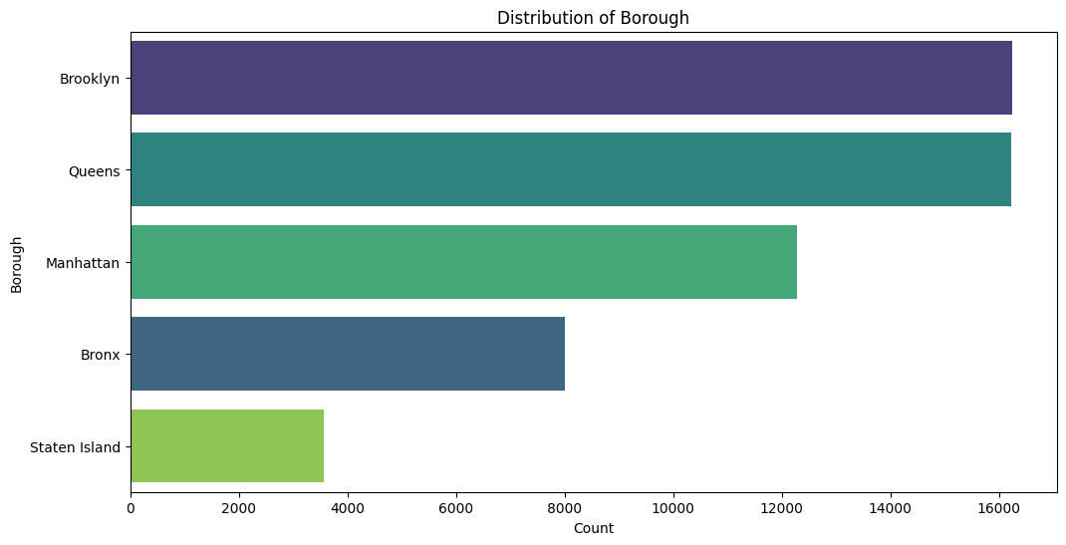

Slide 15
Task 1-classification
Predict whether a business license issued by DCWP is likely to lapse (1) or renew (0) using available license-level attributes.
The goal is to identify renewal behavior patterns to support DCWP in prioritizing renewal reminders and compliance outreach.
🧩 Dataset Overview
Data Source: NYC Open Data — DCWP Issued Licenses
Key Features Used:
Business Category → industry sector of the licensee
Borough → geographic region
License_Duration → calculated from Initial Issuance Date to Expiration Date (in days)
Target Variable: Lapsed (1 = license not renewed)
Size: 56,000+ records after cleaning and transformation.

Slide 16
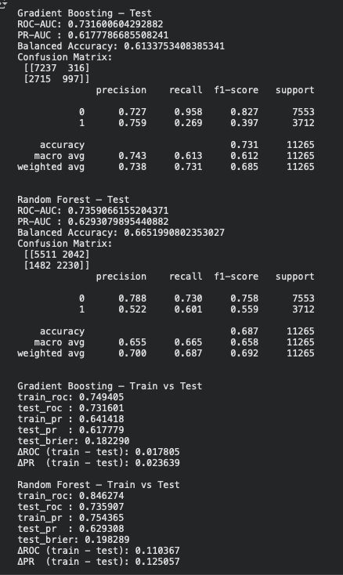
🤖 Models Trained
Two tree-based models were implemented and compared:
Model | Key Characteristics
Gradient Boosting Classifier | Sequentially builds weak trees, focusing on difficult samples; well-calibrated and strong generalization.
Random Forest Classifier | Ensemble of independent trees (bagging); robust, slightly higher recall, minor overfitting risk.

Slide 17
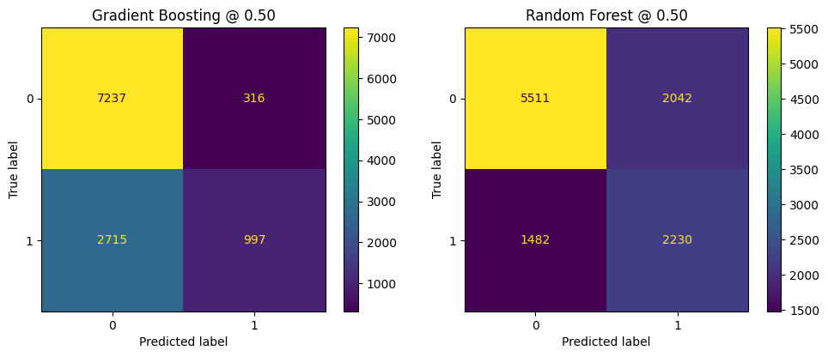
TRAINING RESULTS

Slide 18
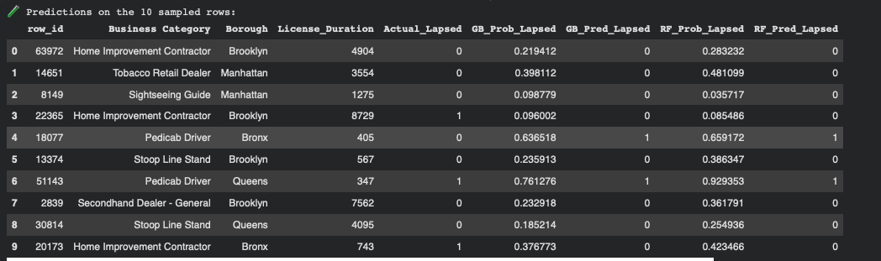
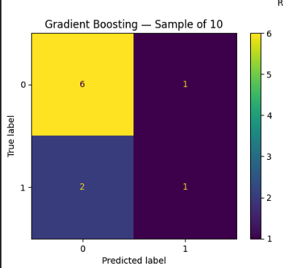
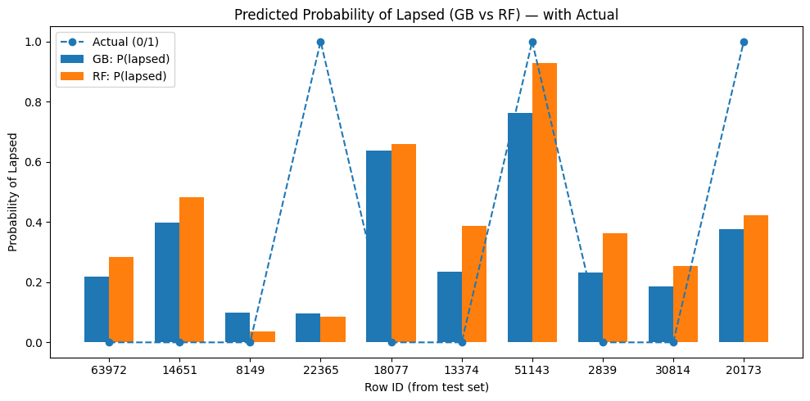
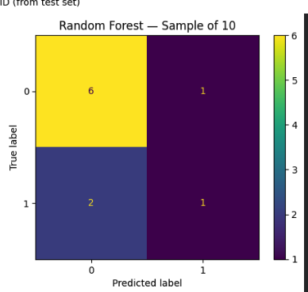
Taking 10 random samples from the dataset to test the model:-

Slide 19

SPEAKING IMPACT
Your ability to communicate effectively will leave a lasting impact on your audience
Effectively communicating involves not only delivering a message but also resonating with the experiences, values, and emotions of those listening

Slide 20
Task 2-REGRESSIOn
Many license records in the DCWP dataset lack valid Latitude / Longitude values.
The goal of this model is to predict both coordinates simultaneously using spatially related categorical features:
1. ZIP Code
2. Borough
3. Business Category

Slide 21
Dynamic delivery
Learn to infuse energy into your delivery to leave a lasting impression
One of the goals of effective communication is to motivate your audience
METRIC | MEASUREMENT | TARGET | ACTUAL
Audience attendance | # of attendees | 150 | 120
Engagement duration | Minutes | 60 | 75
Q&A interaction | # of questions | 10 | 15
Positive feedback | Percentage (%) | 90 | 95
Rate of information retention | Percentage (%) | 80 | 85

Slide 22
🤖 Models Trained
Two tree-based models were implemented and compared:
Model | Key Characteristics
Random Forest Regressor | Best performance, high stability, interpretable feature importances
Gradient Boosting Regressor | Comparable accuracy with finer calibration potential

Slide 23
Task 1-classification
Predict whether a business license issued by DCWP is likely to lapse (1) or renew (0) using available license-level attributes.
The goal is to identify renewal behavior patterns to support DCWP in prioritizing renewal reminders and compliance outreach.
🧩 Dataset Overview
Data Source: NYC Open Data — DCWP Issued Licenses
Key Features Used:
Business Category → industry sector of the licensee
Borough → geographic region
License_Duration → calculated from Initial Issuance Date to Expiration Date (in days)
Target Variable: Lapsed (1 = license not renewed)
Size: 56,000+ records after cleaning and transformation.

Slide 24
FINAL TIPS & TAKEAWAYS
Consistent rehearsal
Strengthen your familiarity
Refine delivery style
Pacing, tone, and emphasis
Timing and transitions
Aim for seamless, professional delivery
Practice audience
Enlist colleagues to listen & provide feedback
Seek feedback
Reflect on performance
Explore new techniques
Set personal goals
Iterate and adapt

Slide 25
SPEAKING ENGAGEMENT METRICS
IMPACT FACTOR | MEASUREMENT | TARGET | ACHIEVED
Audience interaction | Percentage (%) | 85 | 88
Knowledge retention | Percentage (%) | 75 | 80
Post-presentation surveys | Average rating | 4.2 | 4.5
Referral rate | Percentage (%) | 10 | 12
Collaboration opportunities | # of opportunities | 8 | 10

Slide 26

THANK YOU
Brita Tamm
502-555-0152
brita@firstupconsultants.com
www.firstupconsultants.com

